Slide 1
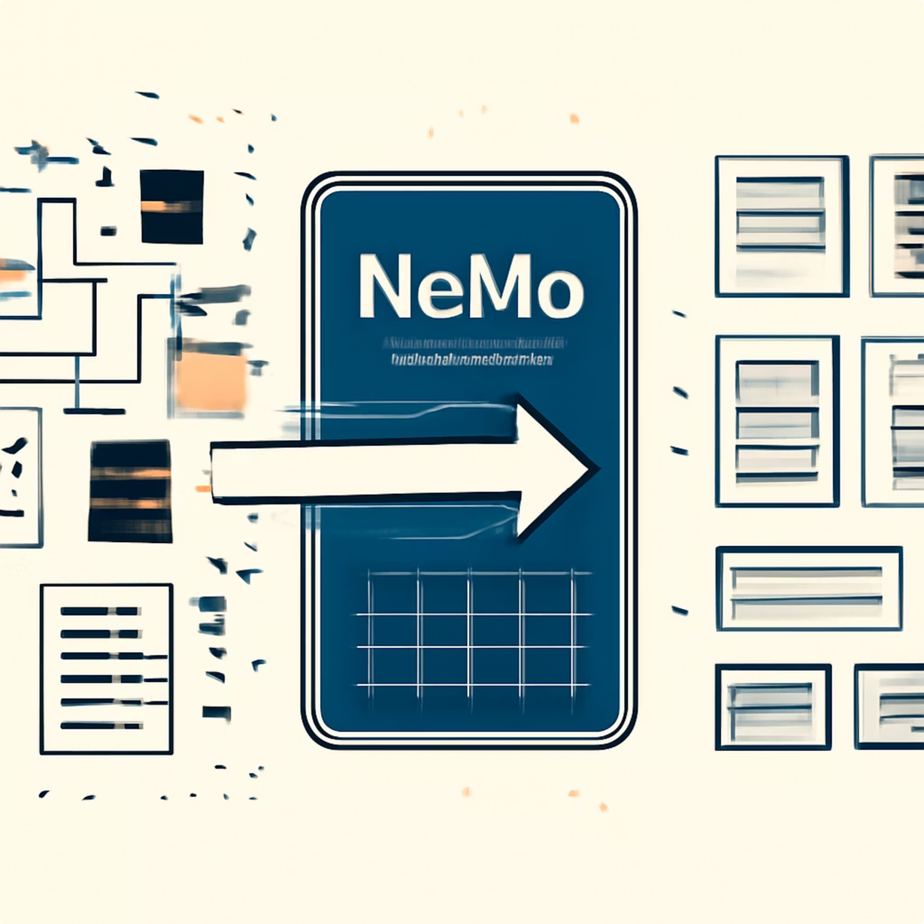
Text Data Curation Pipeline
Using NVIDIA NeMo Curator Concepts — Building clean, high-quality datasets for AI/ML training
BY- Advit Budhiraja - 1024240130
Batch- 2X14
Notes:
1

Slide 2
The Problem with Raw Data
Why Raw Data Falls Short
Our Objective
Raw conversational datasets are rarely ready for AI training. They contain noise, duplicates, and low-quality entries that silently degrade model performance.
Design and implement a curation pipeline that produces a structured, high-quality dataset suitable for AI/ML tasks — by cleaning, filtering, and deduplicating raw text.
Target Applications
Noise & Inconsistency
Duplicate Entries
Low-Quality Text
Formatting issues, irregular casing, and spacing errors
Repeated data reduces diversity and wastes compute
Meaningless or very short entries skew model learning
💬 Chatbot Development
🧠 NLP Models
🤖 Conversational AI
🔬 LLM Fine-Tuning
Notes:
2

Slide 3

Pipeline Overview
A structured, seven-stage pipeline transforms raw text into a clean, structured JSONL dataset ready for AI training.
Ingest Data
Convert to JSONL
Clean Text
Apply Filters
Each stage is designed to progressively improve data quality — the final output is a lean, consistent dataset optimized for model training efficiency.
Notes:
3

Slide 4
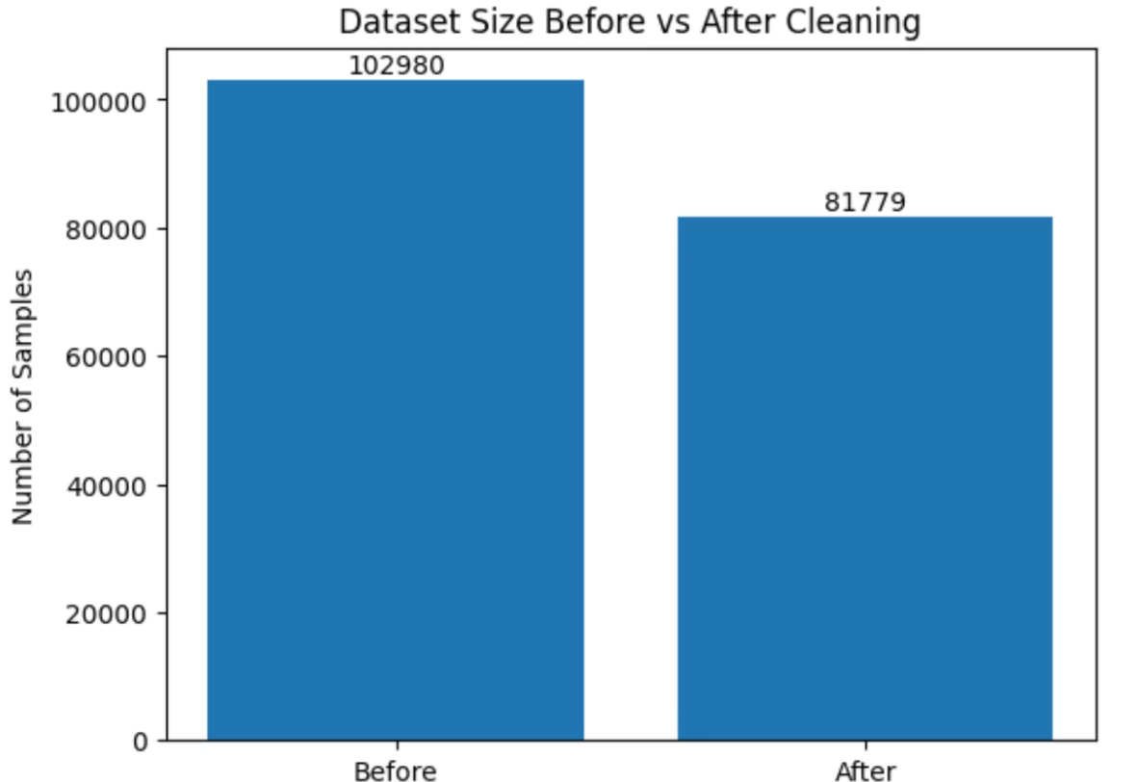



Cleaning, Filtering & Deduplication
What the Pipeline Does
Text Cleaning
Lowercase normalization, extra space removal, Unicode fixing, and punctuation correction for consistency
Filtering
Eliminates very short entries and numeric-only content — retaining only meaningful textual data
Deduplication
Identifies and removes duplicate sentences, improving dataset diversity and model generalization
Measured Results
5000
4680
6.4%
Samples Before
Samples After
Data Reduced
Average sentence length dropped from 13.61 → 12.17 words, indicating successful removal of redundant conversational patterns while preserving natural diversity.
Notes:
4

Slide 5







Tech Stack & Challenges
Tools Used
Challenges & Solution
Platform Limitation
NeMo Curator is Linux-only — incompatible with macOS environments
Python
JSON / JSONL
Version Compatibility
API mismatches and import errors encountered in Colab across library versions
Dataset Issues
Regex
Matplotlib
Several datasets deprecated; required manual loading and handling
A custom Python pipeline was implemented manually — delivering full control, stability, and deeper process understanding.
NeMo Curator
Notes:
5

Slide 6

Future Improvements
The pipeline lays a strong foundation — these enhancements would bring it closer to industry-grade data curation.
1
2
3
Word-Based Filtering
Profanity Filtering
Language Detection
Finer quality control at the vocabulary level
Remove inappropriate or harmful content automatically
Handle multilingual datasets with targeted processing
4
5
Semantic Deduplication
Quality Scoring
Detect and remove near-duplicate meaning, not just exact matches
Rank and prioritize dataset entries by measurable quality
Notes:
6

